Slide 1

Cyber Diagnostics Lab: A Digital Health Checkup
GROUP 09
PG-DCSF | Centre for Development of Advanced Computing (C-DAC), Thiruvanathapuram | August 2025

Slide 2
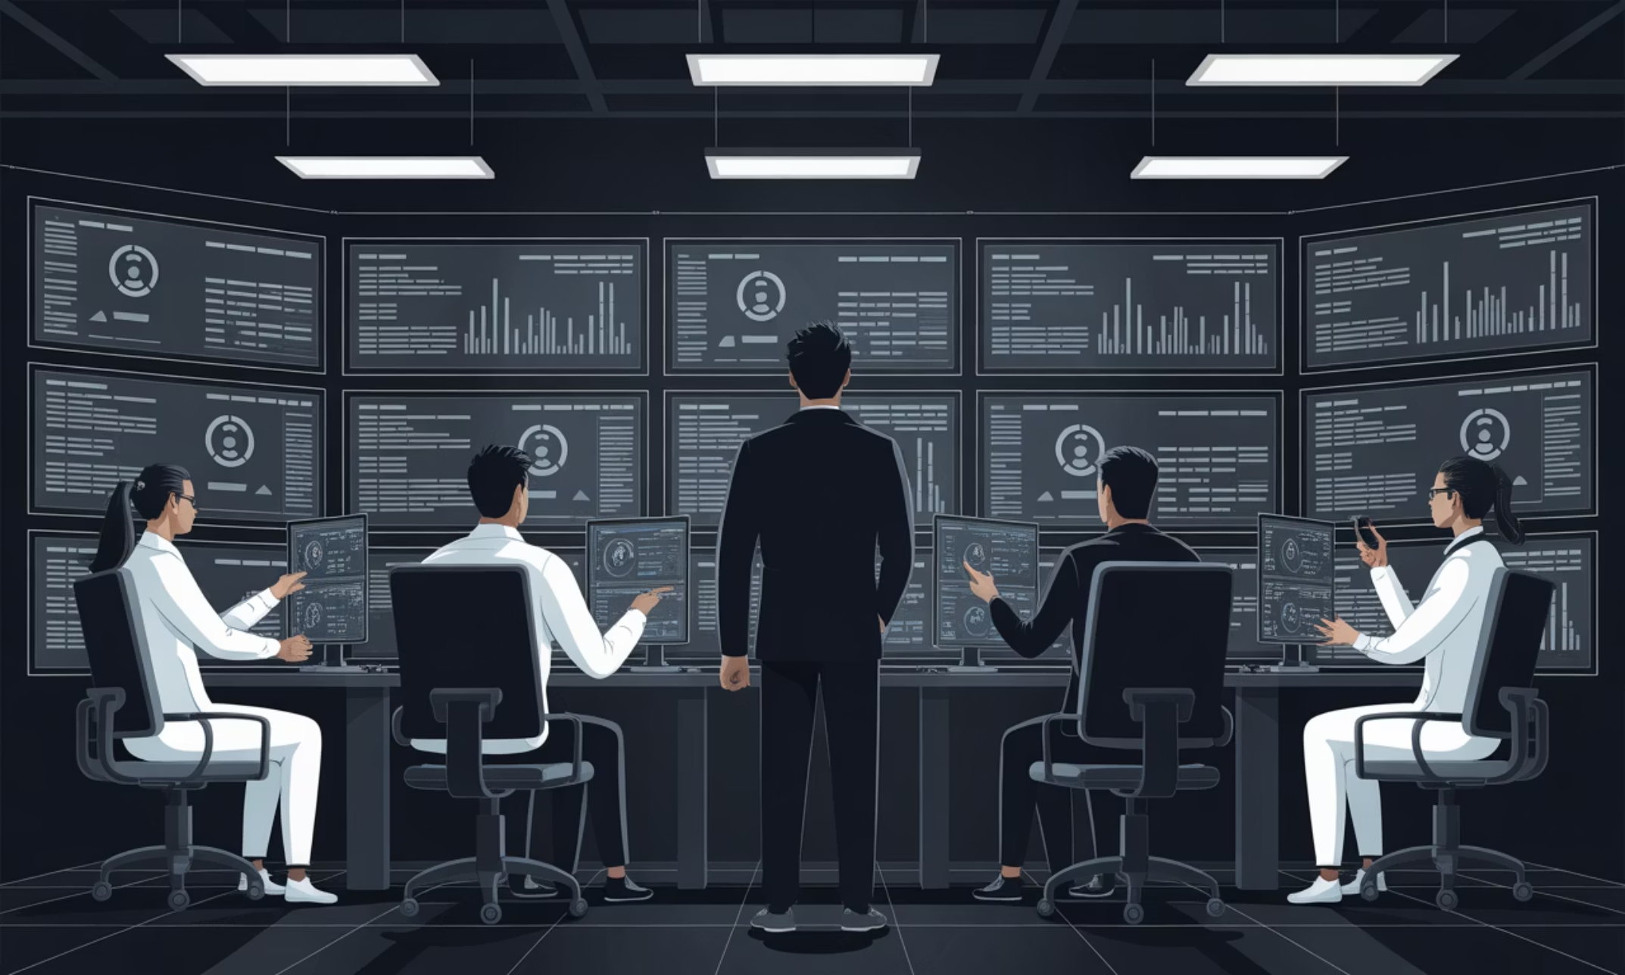
Project Team
Expert Guidance & Development
Under the Guidance of:
Mr. Jayaram – Centre Coordinator
Dr. Priya P. Sajan – Project Guide
Development Team: Dhananjay Shivarkar, Shubham Joshi, Khilesh Mahajan, Rasika Mahajan, Sagar Chaudhari, Uday Sambare
Notes:
• This slide introduces the project team and the key individuals involved in guiding and developing the project. • At the top, we have the project coordinators - Mr. Jayaram, the Centre Coordinator, and Dr. Priya P. Sajan, the Project Guide. They are providing oversight and direction for the project. • Below that, we have the development team - Dhananjay Shivarkar, Shubham Joshi, Khilesh Mahajan, Rasika Mahajan, Sagar Chaudhari, and Uday Sambare. This is the group that has been responsible for the hands-on work of actually building and implementing the project. • The image in the background is a generic cybersecurity operations center, which helps set the context for the project. • The key message here is to acknowledge the expert guidance and capable development team that is driving this important initiative forward.

Slide 3




Project Overview
Web-Based Platform
Intelligent Scanning
Automated cybersecurity diagnostic system performing comprehensive security health checks of web applications and infrastructure
Domain and IP address vulnerability assessment with real-time progress tracking and detailed reporting capabilities
Admin Control
Cost-Effective Solution
Comprehensive admin panel for user monitoring, activity tracking, and centralized security management
Accessible alternative to expensive enterprise VAPT tools, democratizing cybersecurity for small organizations

Slide 4

The Cybersecurity Challenge
Rising Threats
Web applications increasingly face sophisticated cyber attacks due to insecure coding practices, misconfigurations, and rapidly evolving threat landscapes
Data at Risk
Modern web applications store and process vast amounts of sensitive data including personal information, financial records, and confidential business intelligence
Resource Gap
Small and medium organizations lack access to expensive enterprise security tools and specialized expertise needed for comprehensive vulnerability assessment
Our Solution
Cyber Diagnostics Lab bridges this gap by automating early vulnerability detection and promoting preventive cybersecurity through accessible, user-friendly technology

Slide 5

Research Foundation
OWASP Top 10 guidelines
Literature Survey Insights
Common web vulnerability controls
Our research examined industry standards and existing solutions to identify critical gaps in the cybersecurity tool landscape.
User accessibility needs
Research Foundations to Solution
NIST Framework standards
OWASP Top 10: Framework for common web vulnerabilities
NIST Cybersecurity Framework: Risk identification and mitigation strategies
Tool Analysis: Nessus and Burp Suite require high expertise and investment
Key Finding: Early vulnerability detection significantly reduces breach impact and recovery costs
Inclusive and usable design
Risk-based cybersecurity practices
Early detection research
Existing tool analysis
Techniques for rapid identification
Strengths and gap assessment

Slide 6




System Architecture & Workflow
Secure Access
Scan Submission
Role-based authentication system separating User and Admin privileges with encrypted credential management
Users submit domain or IP addresses through intuitive interface with real-time validation and queue management
Live Analysis
Detailed Reports
Automated security modules execute comprehensive checks with live progress indicators and status updates
Generated vulnerability reports with risk categorization, audit trails, and actionable remediation recommendations
Admin panel features include centralized dashboard, user management (company affiliation, role assignment, status tracking), and comprehensive activity monitoring for security auditing.

Slide 7
Security Analysis Framework
01
Risk Classification
Infrastructure & Asset Identification
Findings categorized into seven severity levels for prioritized remediation:
Comprehensive discovery of digital assets, network topology, and exposed services
Critical – Immediate action required
High – Urgent remediation needed
Medium – Schedule for resolution
Low – Address when possible
Informational – Awareness notices
Passed – Security controls validated
02
Security Configuration Analysis
Deep inspection of server configurations, SSL/TLS settings, and security headers
Each finding includes detailed technical descriptions and actionable remediation guidance.
03
Threat Intelligence & Abuse Checks
Cross-reference against known threat databases and blacklists for malicious activity indicators
04
Web Application Risk Analysis
Automated testing for injection flaws, authentication weaknesses, and data exposure vulnerabilities
05
Behavioral Risk Analysis
Pattern recognition for suspicious activities and anomalous application behavior

Slide 8
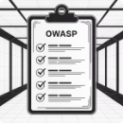


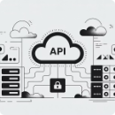



Future Roadmap & Conclusion
Full OWASP Coverage
AI-Powered Detection
Compliance Reporting
Cloud & API Security
Complete automation of OWASP Top 10 vulnerability detection with advanced testing modules
Machine learning algorithms for intelligent anomaly detection and predictive threat analysis
Automated PDF generation and regulatory compliance report formatting for audit requirements
Extended assessment capabilities for cloud infrastructure and API endpoint vulnerability testing
Real-Time Alerts
Scalable Deployment
Instant notification system for critical vulnerability discovery and security incidents
Cloud-based architecture for enterprise-grade scalability and global accessibility
Project Achievement: Successfully developed an automated cybersecurity diagnostic platform that demonstrates real-world security practices while providing accessible vulnerability assessment capabilities for academic and practical applications.
References: OWASP Foundation | Flask Documentation | SQLAlchemy ORM | NIST Cybersecurity Framework | Python Security Best Practices

